Slide 1

brand guidelines
Rev: 6.2.22

Slide 2
How to use this guide.
Hello! Here is everything you need to know about the USEFULL brand.
Feel free to copy and paste any of the language used in this deck. If you are looking for any of the ‘brand assets’ - icons, infographics or backgrounds - check out the Brand Asset folder and insert files from there.
Questions? Email Ellie or Angela.

Slide 3
The brand.

Slide 4
The brand.
SETTING THE STAGE
After all the hard work put into creating a cohesive brand identity, we want to ensure when it’s presented to the world we are following these guidelines. Doing so will ensure your logo and personality is used in a way that upholds the established standards and keeps your brand look and sounding professional.

Slide 5



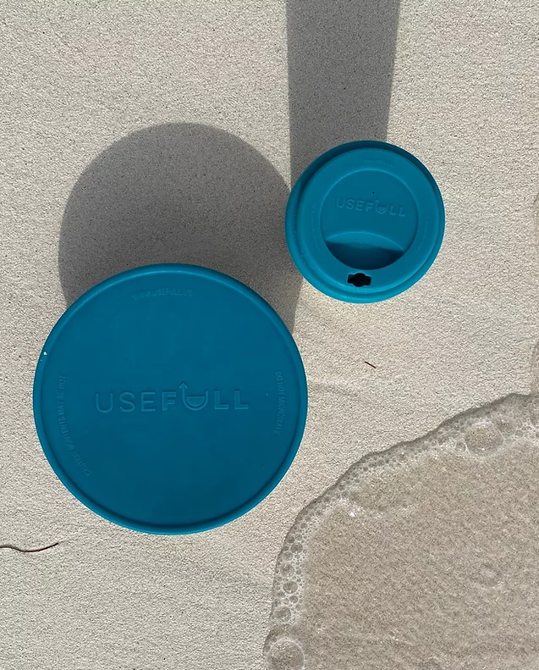

The brand.
SIMPLE
PREMIUM
RESPONSIBLE
MOODBOARD
The inspiration for Usefull’s logo and brand is the ocean.
Wanting to show the depth of the brand’s values, adding a premium,sustainable, and modern feel. Clean lines make it feel professional and inviting. The vibe of the brand should facilitate a sense of responsibility, simplicity and high quality.

Slide 6
Brand values.
1. ELEVATE THE TAKEOUT EXPERIENCE
a. Premium - food and drinks stay hot
b. Sustainable and plastic free- designed stainless steel containers with silicone lids
c. Sleek, effective way to enjoy food without packaging waste
2. DIFFERENT WAY TO LIVE
a. Circular economy*
3. GLOBAL AWARENESS & ACTIVISM
a. Waste/climate change (also: social justice/race/poverty) relationship
a. Data driven - backed by research, support by real time impact
b. Educational - providing value beyond system and inventory
c. Savings - environmental and financial
*an economy that uses a systems-focused approach and involves industrial processes and economic activities that are restorative or regenerative by design
SIMPLE CHANGE → BIG IMPACT

Slide 7
Target audiences.
Customer:
College Leadership
Corporate Leadership
Community Leaders
Restaurant Owners
Dining Service Managers
End User:
College Students
Community Members
Corporate Employees

Slide 8
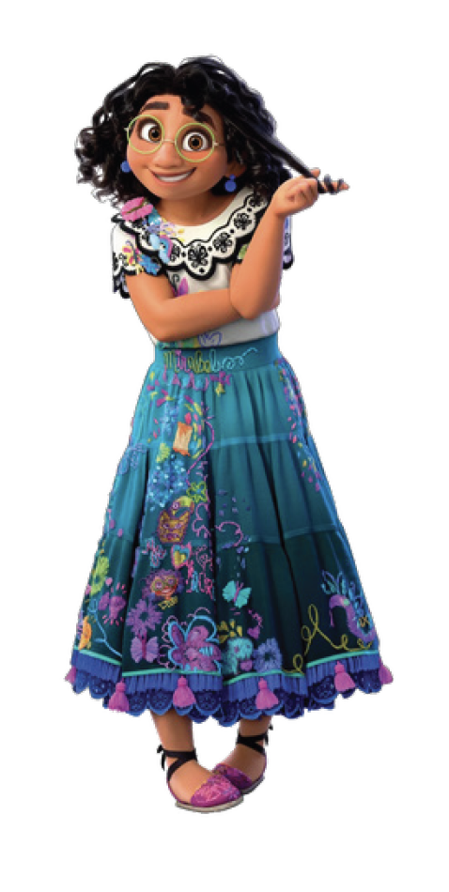
Brand personality.
USEFULL IS
“Zero waste”
Reduced waste
Premium
Convenient
Simple
Educational
Sustainable
Responsible
Reliable
Chic
Data driven
Healing
Helpful
Cultural affect
Exclusive
Early adopter
Maverick
Circular economy
Service
Useful
Family
USEFULL IS NOT
Greenwashing
Wasteful
Know it all
Exclusionary
Inaccurate
Preachy
Bossy
Tribe
Only coffee
BRAND PERSONALITY - MIRABEL MADRIGAL
Mirabel is normal (compared to her gifted family members) but that doesn’t stop her from standing up for what’s right and changing the lives of her family and community for the better. She is passionate but kind, helpful and brave.
USEFULL is here to help, just like Mirabel. With a kind but strong tone - taking time to educate while standing up for what’s right. Understanding the lives and challenges of their target audiences, USEFULL takes the pain out of change. Bringing hope while adding value - a solution without sacrifice

Slide 9
What we say.
A PLASTIC-FREE FUTURE
starts here.
WE ENABLE ORGANIZATIONS TO MEET THEIR zero-waste goals.
Our mission
Replace single use packaging with our plastic-free, returnable system.
LIVE usefull™

Slide 10
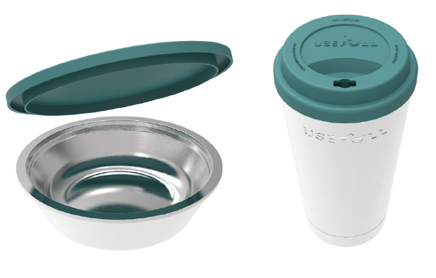

The products
CUPS & CONTAINERS
100% PLASTIC FREE
Premium takeout experience - food and drink stay at their desired temperature
Made from stainless steel, double walled and vacuum insulated
Silicone lids create a tight seal
Stackable and dishwasher safe
No microwaving necessary
TECHNOLOGY
App powered and easy to use - the USEFULL technology makes our returnable system work like clockwork.
Real time impact data dashboard
Easy inventory management
Simple check out/return process
Due date reminders
Location based information
Available on iOS and Android

Slide 11




How it works.
STEP 1
DOWNLOAD THE APP
Enter credit/debit/student card.
STEP 2
ORDER
Just as you normally would.
STEP 3
CHECK OUT & ENJOY
Use app to check out with cup/container’s QR code.
STEP 4
SCAN & RETURN
Yup, it’s that simple.

Slide 12
The logo.

Slide 13


Primary logo.
PRIMARY LOGO
Usefull’s primary logo* is a wordmark. The lettering is a classic san-serif font, leading the eye to the mark of the brand — the “U” in full, representing a container with food/drink - the main feature of the brand, making it recognizable and memorable.
This is a main logo that will be used across primary brand applications. This logo helps audiences easily identify Usefull’s, products and offerings, web presence, ads and other materials, and enhances the professionalism of the brand. It is essential to the success of the brand that the logo always be applied with care and respect in every application according to these guidelines.
The icon mark can be used when the full primary logo is not necessary or in a case where the brand name is already displayed in plain text. For example, the icon could be used as a profile picture on Instagram since the user name is in plain text.

Slide 14

Primary logo.
MINIMUM SIZE
The smallest the icon should be represented is .5” high.
MINIMUM SIZE
The smallest the logo should be represented is .5” high.
LOCATION LOGO VARIATIONS
The location name and solid map shape is to remain consistent - to the top left of the arrow, both in slate.

Slide 15

Logo color usage.
CLEAR SPACE
To ensure legibility, always keep a minimum clear space around the logo. This space isolates the mark from any competing graphic elements like other logos or body copy that might conflict with, overcrowd and lessen the impact of the mark.
The minimum clear space is defined as the width of the arrow for the icon. For primary logo the width of the bowl contents. This minimum space should be maintained as the logo us proportionally resized.
The color usage for Useful is modern, clean, minimalistic with a nod to ocean colors.
The logo will mostly be used in the primary palette against a white or neutral background, but can also be used in white or a lighter color from the secondary palette against darker background.

Slide 16
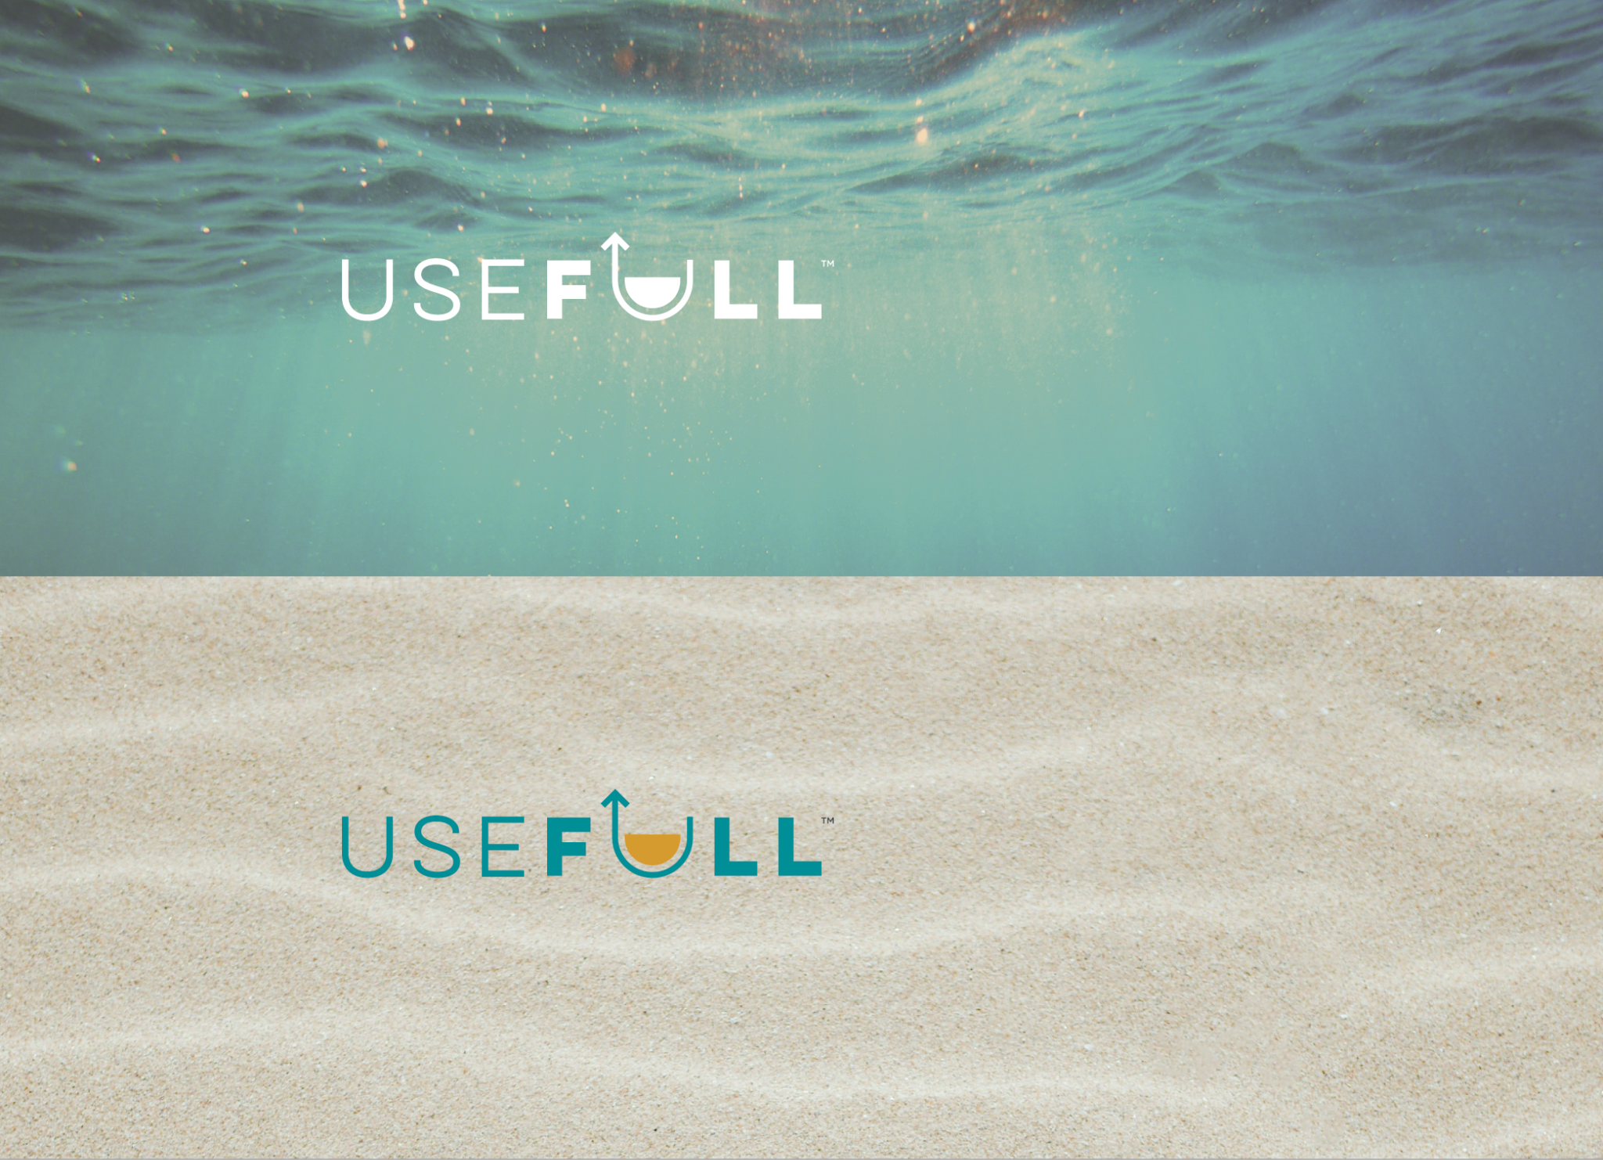
Photo backgrounds.
There are a couple of ways the logo can be used on photographic backgrounds, but each option should be exercised with care, making sure the logo and type are not obstructed by the image.
In most cases, you can use either a solid white or the primary logo on top of a background image.
TIPS
1. Photos with shallow depths of field work best.
2. Avoid busy images with too much detail.
3. Applying darker transparent overlay on an image helps makes the text more readable.

Slide 17
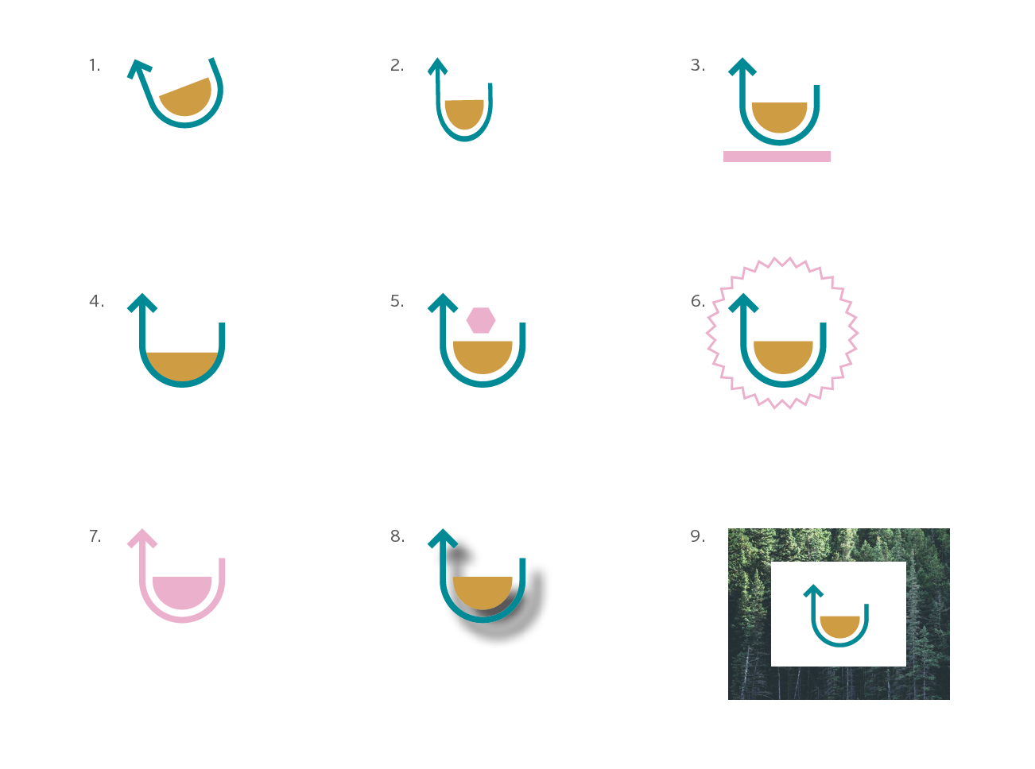
Unacceptable use.
A few rules are necessary or maintaining the
integrity of the brand, Don’t compromise the overall look of the logo by rotating, skewing, or distorting in any way - that includes adding unnecessary and unattractive text decorations like drop shadows and outlines. Here are a few examples of some ways you should never use the logo.
1. Don’t rotate the design
2. Don’t squish or stretch
3. Don’t place elements in
the logo clear space
4. Don’t resize any part
5. Don’t rearrange parts or
create components that
are not already provided
6. Don’t add unofficial
graphics to the logo.
7. Don’t use non-brand colors.
Reference the Color Usage
Section,
8. Don’t add drop shadows
or other text styles.
9. Don’t contain the logo in a box when used with a background.

Slide 18
Typography and color system.

Slide 19
Typography.
Typography is a powerful brand tool when used consistently.
The art of typefaces best represent the bold and modern feel of the brand and should be used across all print and web applications.
Merriweather bold Use for headlines. Sentence case or lowercase.
ABCDEFGHIJKLMNOPQRSTUVWXYZ 1234567890
Proxima Nova Use for headlines and body copy. Sentence case or uppercase.
ABCDEFGHIJKLMNOPQRSTUVWXYZ 1234567890

Slide 20
Color palette.
PRIMARY PALETTE
SECONDARY PALETTE
SUNNY CMYK: 0 44 73 12 RGB: 224 126 60 HEX: E07E3C
SKY CMYK: 79 26 0 24 RGB: 41 143 194 HEX: 238DC1
EARTH CMYK: 42 23 35 0 RGB: 154 173 164 HEX: 9AADA4
WAVE CMYK: 24 0 2 20 RGB: 143 204 200 HEX: 8FCCC8
FOAM CMYK: 12 0 6 0 RGB: 222 241 238 HEX: DDF0EE
FOG CMYK: 0 0 2 7 RGB: 237 236 232 HEX: EDECE8
SLATE CMYK: 0 0 0 85 RGB: 77 77 79 HEX: 4C4C4E
Color is an integral part of brand identity. Consistent use of the color palette will not only reinforce the cohesiveness of the brand but the color also serves a psychological purpose but communicating a certain feel to your audience.
In the primary palette Deep Teal and Golden is fresh and often used to evoke feelings of trustworthiness and reliability.
In the secondary palette which is complementary to the primary palette, Slate and Sunny are evoke strength, friendliness and fun. The lighter hues are warm, crisp, clean and inviting, representing the earth and dependability and best used for icons, infographics and backgrounds.
DEEP TEAL PMS 321 C CMYK: 100 6 0 42 RGB: 0 140 149 HEX: 008C95
GOLDEN PMS 7563 C CMYK: 0 28 79 16 RGB: 214 154 45 HEX: D69A2D
ICONS:
Use the colors: Golden, Sunny, Sky, Earth, Wave
BACKGROUNDS:
Use the colors: Foam, Fog
TEXT:
Use Slate with the exception of Deep Teal for headers.

Slide 21
Collateral and additional assets.

Slide 22
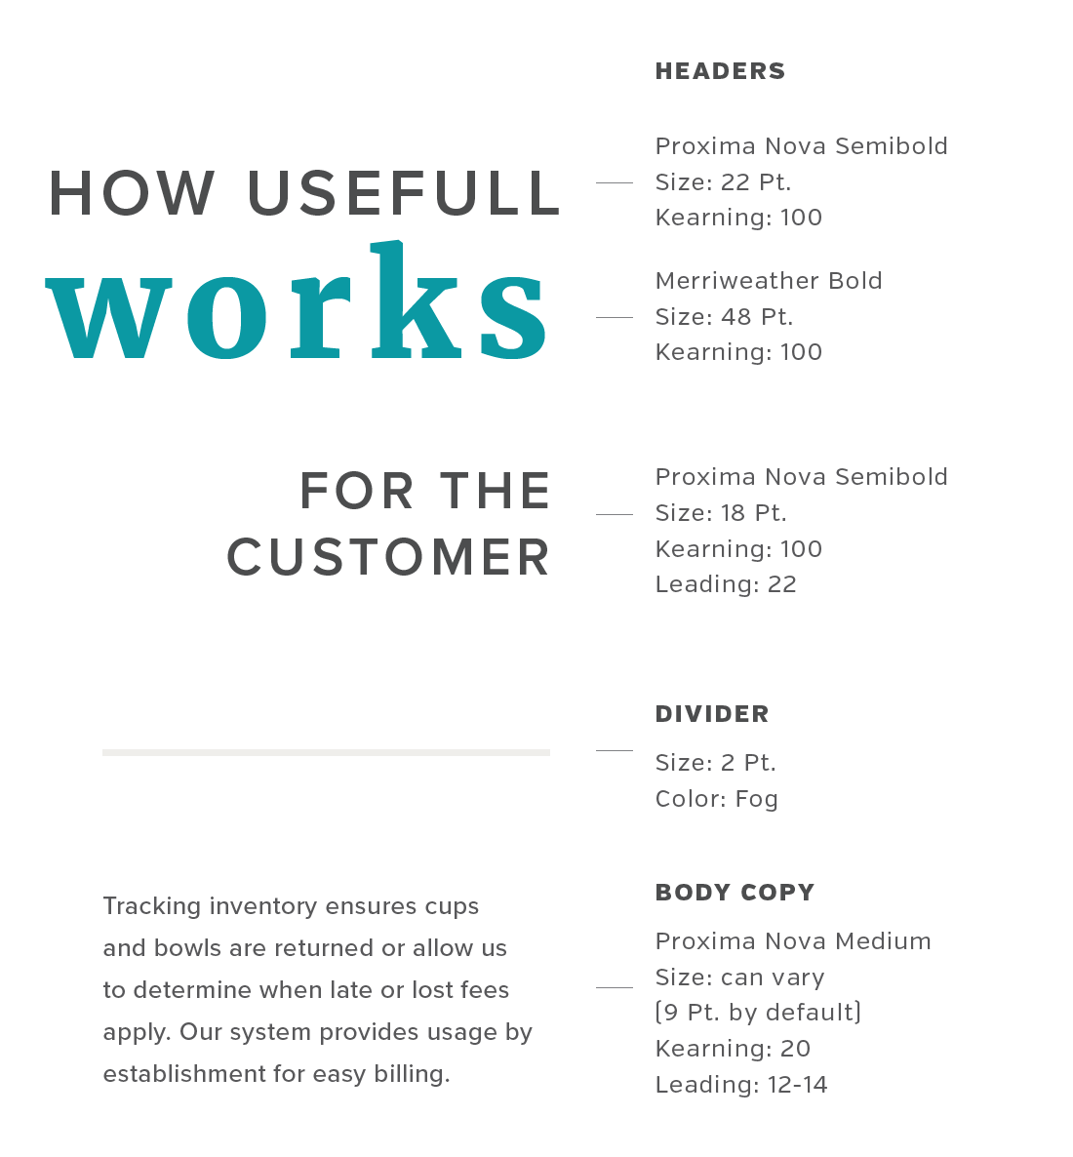
Collateral.
COLLATERAL
Keeping collateral consistent with use of the color palette and fonts is an integral part of brand identity. The following guides are recommended for flyers, one-pagers and collateral of the same size.

Slide 23
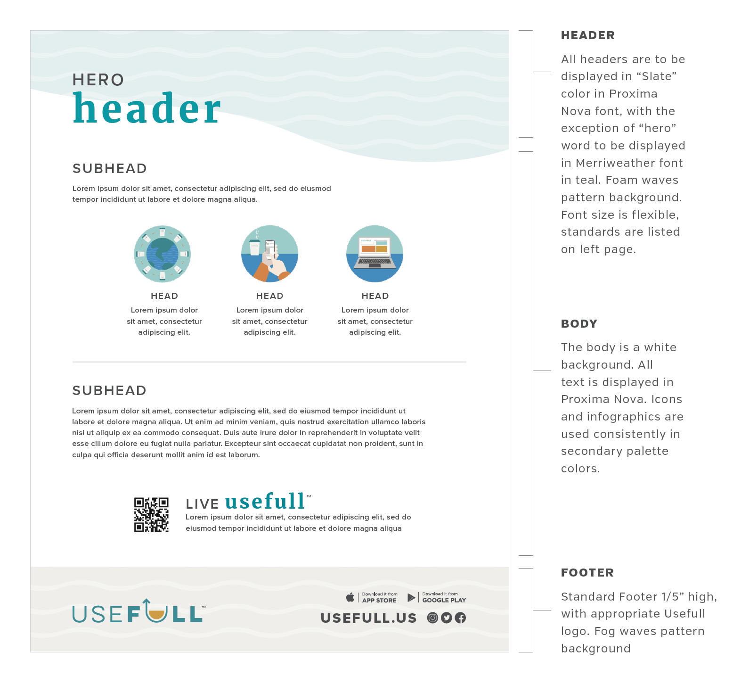
Collateral.

Slide 24
Icons, infographics and additional assets.
ICONS
Our icon system is simple, clean, and open. Use standard icons in marketing materials, presentations, web content, infographics, and diagrams. They’re intended to be used at small sizes. If you need a larger visual, use an illustration or infographic.
All icons use the same stroke weight and corner radii, show objects from the front when possible, use flattened perspective, and are made from geometric shapes. They’re available in the secondary color palette. Colors are interchangable but should be used with consistency.
PRIMARY ICONS / COLORS
For icons, infographics and additional assets - please use the brand asset folder.

Slide 25





















Icons, infographics and additional assets.
ICON LIBRARY
For icons, infographics and additional assets - please use the brand asset folder.

Slide 26
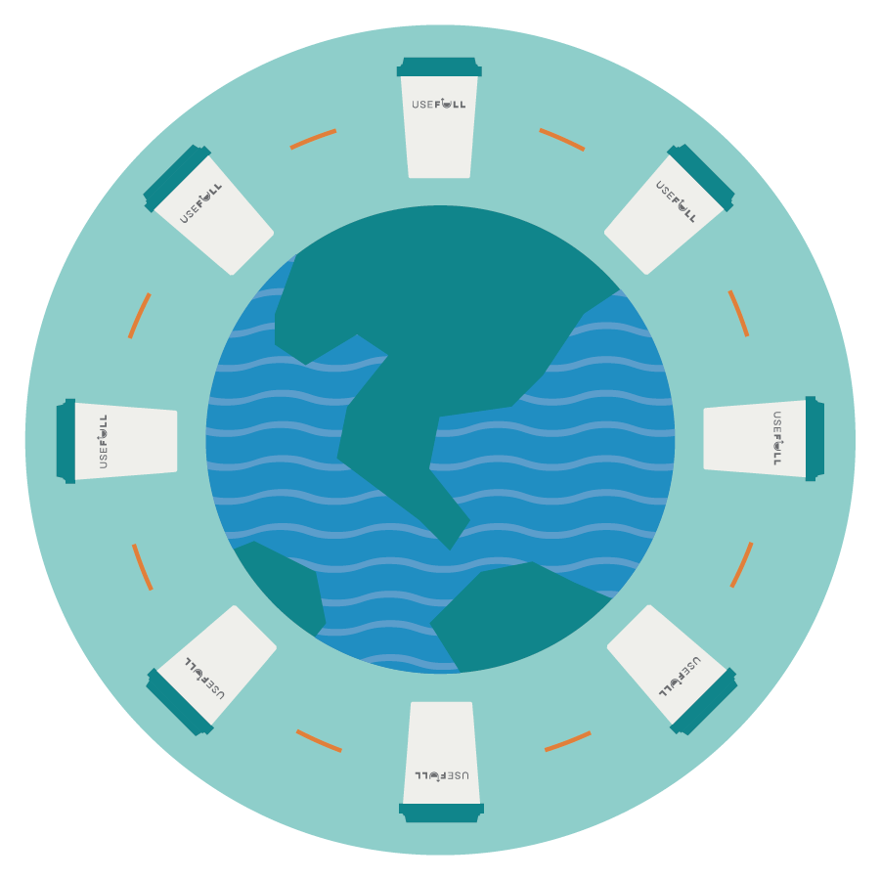





Icons, infographics and additional assets.
INFOGRAPHICS AND ILLUSTRATIONS
Our infographic system should match the icon system with simple, clean, and open illustrations. All illustrations and infographics should use the same stroke weight and corner radii, show objects from the front when possible, use flattened perspective, and are made from geometric shapes. Available in the primary and secondary color palette, colors are interchangeable but should be used with consistency.
ADDITIONAL ASSETS
WAVES Use of waves in collateral background with secondary color palette applied.

Slide 27


